Slide 1


Revolutionizing Movie Ticketing
The current movie ticket booking process can be frustrating. Our solution is a modern, user-friendly system.
Enjoy convenience, efficiency, and valuable insights with our platform. We're changing how people experience movies.
by Aryan Mehra

Slide 2
Seamless Booking Experience
Intuitive Interface
Multiple Payment Options
Our UI ensures smooth navigation.
Credit cards, debit cards and mobile wallets are supported.
Real-time availability of seats and showtimes.

Slide 3

Enhancing User Engagement
Personalized Recommendations
Loyalty Program
Exclusive discounts and special offers.
Recommendations based on viewing history.
Social Sharing
Invite friends and post reviews easily.

Slide 4




Robust Backend Infrastructure
Cloud-Based
Secure Payment
Analytics Dashboard
Cloud architecture on AWS or Azure ensures reliability. We integrate secure payment gateways with PCI DSS compliance.

Slide 5



Technology Stack
1
React
2
Node.js
3
MongoDB
Our frontend uses React, JavaScript, HTML5, and CSS3. The backend is built with Node.js and Python. We utilize MongoDB and PostgreSQL databases.

Slide 6

Sustainable Revenue Model
Ticket Commissions
5-7% per ticket sale.
Premium Subscriptions
Exclusive content.
Advertising
Targeted ads.

Slide 7




Competitive Advantages
Superior UX
Better than existing platforms.
Data-Driven Insights
Valuable for cinema operators.
Customer Loyalty
Focus on retention.

Slide 8
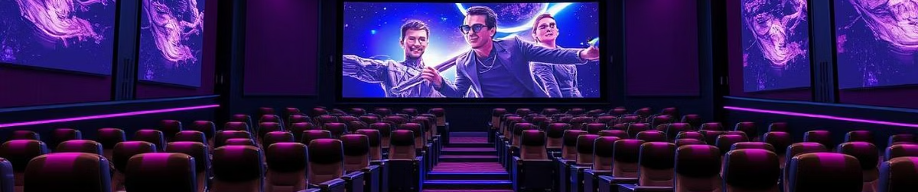
The Future of Movie Ticketing
We offer key features and great benefits. Partner with us to transform the moviegoing experience.
Join us to redefine how people book and enjoy movies. Together, let's innovate the movie industry!

